Slide 1
45 Day Check-in and Preparing for Budget Development
GO Team Business Meeting #3

Slide 2
Agenda
Continuous Improvement Plan
45 Day Check-in
Fall to Winter MAP Data Discussion
Review of Strategic Plan and priorities progress
Strategic Plan Updates
Preparing for the Budget Development
Rank Strategic Priorities

Slide 3
Timeline for GO Teams
You are HERE
Fall 2021
GO Team Developed 2021-2025 Strategic Plan
1
Summer 2023
School Leadership completed Needs Assessment and defined overarching needs for SY23-24
2
August 2023
School Leadership completed 2023-2024 Continuous Improvement Plan
3
Sept. – Dec. 2023
Utilizing current data, the GO Team will review & possibly update the school strategic priorities and plan
4
Before Winter Break
GO Team will take action (vote) on the school’s strategic plan and vote on the ranked strategic plan priorities for SY24-25 budget discussions.
5
1
2
3
4
5

Slide 4
Continuous Improvement Plan

Slide 5
Quarterly CIP Check-in
As part of the Continuous Improvement process, all APS schools are completing a quarterly check-in for the Continuous Improvement Plans.
Questions to Consider
Based on our year long CIP plan, what are the actions that the school has already completed?​
What data supports the completion of an action step and success criteria (both implementation and student achievement)?

Slide 6
CIP Quarterly Check-In

Slide 13
Data Discussion

Slide 14
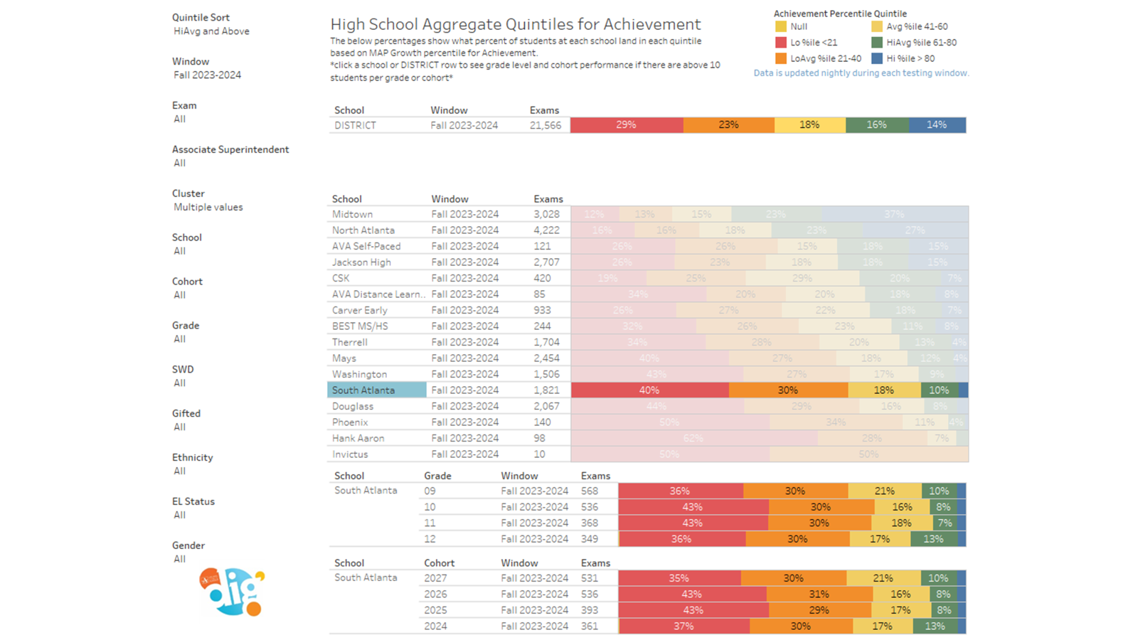
Fall MAP Results

Slide 15
Winter MAP Results
Before Presenting to your GO Team:
Insert School’s 2023 Winter MAP Results – use as many slides as necessary

Slide 16

GO Team Discussion:
Data Protocol
What do you notice?
What are your wonderings?
What additional questions do you have?

Slide 17
Strategic Plan Progress

Slide 18
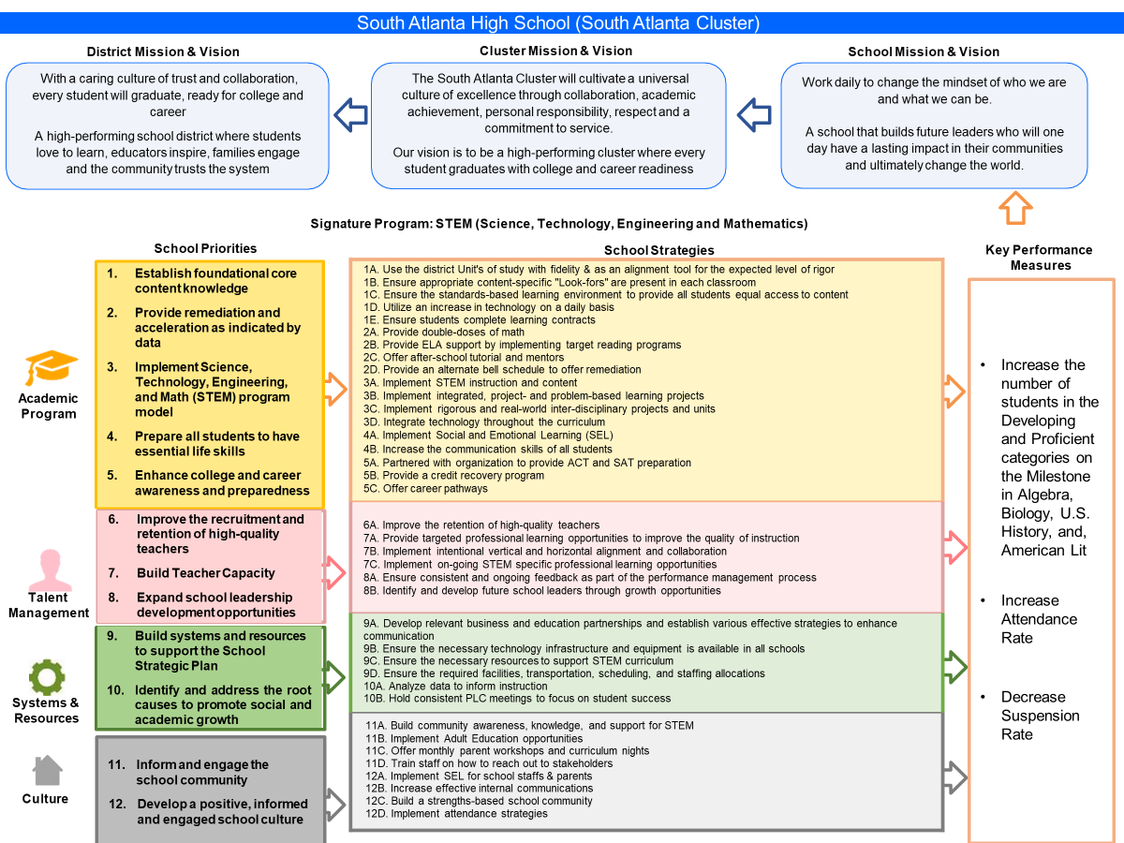
Our Strategic Plan

Slide 19
Activity & Discussion
GO TEAM DISCUSSION: Review the priorities and goals in your strategic plan and reflect on if the expected progress is being made. These guiding questions will help you determine what, if any, updates are needed for your school’s strategic plan.
What progress has been made towards the priorities identified in our Strategic Plan? What evidence/data do we have?
Lesson plan preparation
Modeling teaching
In core content areas, such as courses participating in the End-Of-course (EOC) assessment, Instructional Coaches and Reading Specialists provide support for
Targeted Skill
School
Literacy
Prescribed questions, higher-order-thinking/questioning, robust question
Students
Teachers
Recognition for perfect attendance, decreased suspension rate
Improving the culture
Workshops

Slide 20
Activity & Discussion
GO TEAM DISCUSSION: Review the priorities and goals in your strategic plan and reflect on if the expected progress is being made. These guiding questions will help you determine what, if any, updates are needed for your school’s strategic plan.
Based on available data, are there any other adjustments we need to make to the Strategic Plan?
Honing the granular details of the Plan
Teaching testing

Slide 21
Updates to the
Strategic Plan
Enter all changes/updates to your plan – be sure to include accountability measures, as appropriate.
No changes/updates were made.

Slide 22
Action on the Updated Strategic Plan
The GO Team needs to TAKE ACTION (vote) on its updated Strategic Plan. After the motion and a second, the GO Team may have additional discussion. Once discussion is concluded, the GO Team will vote.

Slide 23
Preparing for
Budget Development

Slide 24
Discussion
Strategic Plan Priority Ranking
In preparation for the 2024-2025 Budget Development (January–March 2024), the GO Team needs to rank its Strategic Plan Priorities. Use the next slide to capture the priority ranking.

Slide 25
Strategic Plan
Priority Ranking
Insert the school’s priorities from Higher to Lower
Higher
Academic Performance
Attendance
Suspension
Lower

Slide 26
Action on the
Strategic Plan Priorities
The GO Team needs to TAKE ACTION (vote) on its ranked Strategic Plan Priorities. After the motion and a second, the GO Team may have additional discussion. Once discussion is concluded, the GO Team will vote.

Slide 27
Where we’re going
At our next meeting we will begin the discussion of the 2024-2025 budget.
Let me or the Chair know of any additional information you need for our future discussion.

Slide 28
Thank you

